Slide 1
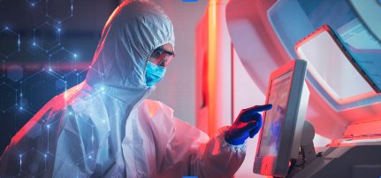
"Smartphone-Based Malaria Parasite Detection“
“A Deep Learning Approach"
Sampath kumar Medam

Slide 2
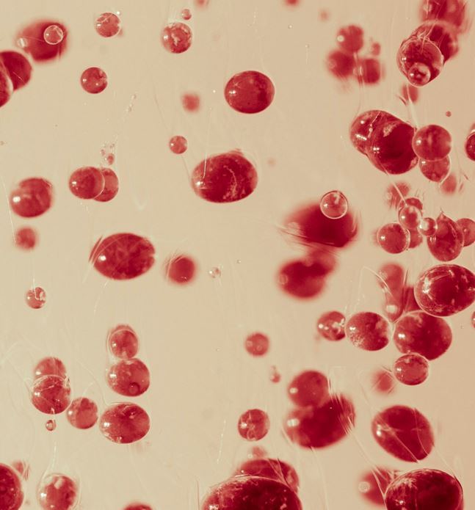
Motivation:
Global Health Challenge: Malaria remains a significant global health threat with millions of cases and thousands of annual deaths.
Limitations of Traditional Diagnosis: Microscopy examination of blood smears is the gold standard but has limitations, including the need for expert parasitologists, time-consuming processes, and potential misdiagnoses.
Resource-Limited Areas: The paper addresses the challenge of expert availability and diagnostic accuracy in resource-limited regions by proposing a smart phone-based automated malaria parasite detection system.

Slide 3
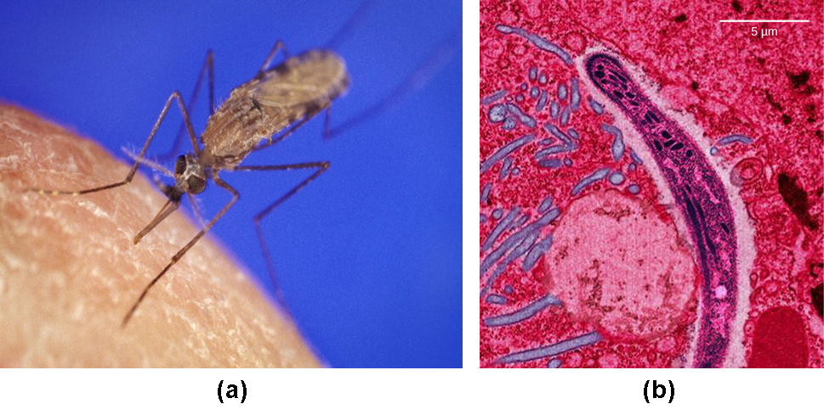
Problem Statement:
Focus on Thick Blood Smear Detection: While various methods exist for malaria detection, this work focuses on the specific problem of detecting parasites in thick blood smears.
Challenges of Traditional Techniques: Traditional methods involving thresholding and morphological operations have accuracy limitations.
Feature-Based and Deep Learning Approaches: Feature-based methods and deep learning techniques are explored, with deep learning showing promise in handling large datasets.

Slide 4
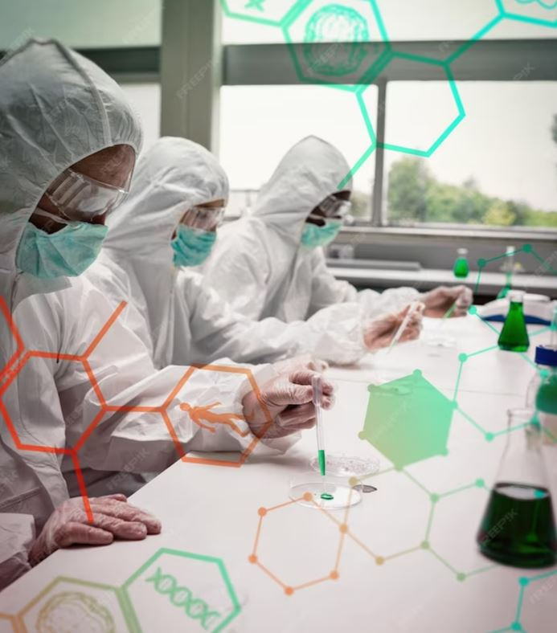
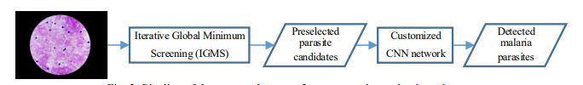
Objectives:
Developing a Smartphone Application: The primary objective is to create a deep learning-based application for smart phones, facilitating rapid and accurate malaria parasite detection.
Providing an Overview: The paper aims to provide an overview of existing approaches, challenges, and the potential of deep learning in this context.
Showcasing Advantages: It showcases the advantages of deep learning in malaria parasite detection.
Presenting Methodology and Results: The paper presents the proposed methodology and its results, highlighting its efficiency and dataset size.

Slide 5
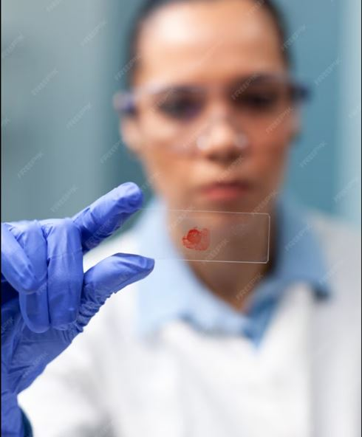
Contributions:
Smartphone-Based Parasite Detection: The paper introduces a novel smart phone-based system for automated malaria parasite detection, combining an innovative pre selection method (IGMS) and a customized Convolutional Neural Network (CNN) for classification.
Efficiency: The system is commended for its efficiency, capable of detecting parasites in high-resolution images on a standard Android smart phone in just about 10 seconds.
Large Dataset Testing: Unlike some prior works, the authors tested their method on a considerably larger dataset, totalling 84,961 annotated parasites from 150 patients. Importantly, this dataset is made publicly available for further research.

Slide 6
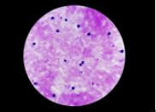
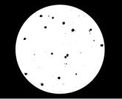

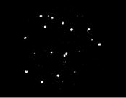
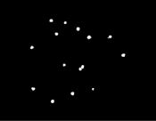
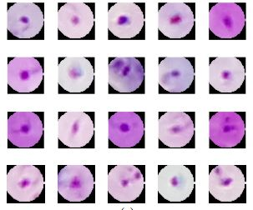
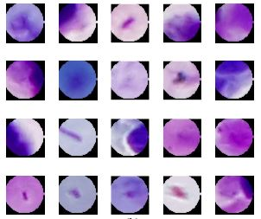
Methodology:
Parasite Candidate Screening:
1.WBC detection involves converting RGB images to grayscale and creating a binary mask to distinguish the foreground from white blood cells.
2.Parasite pre selection using IGMS (Iterative Global Minimum Screening) localizes minimum intensity values, generating circular patches, narrowing the search to around 500 parasite candidates.
thick blood smear
detected objects using
otsu thresholding
view mask
detected WBC's
with some noise
Clear WBC's after
filtering
positive patches
negative patches

Slide 7
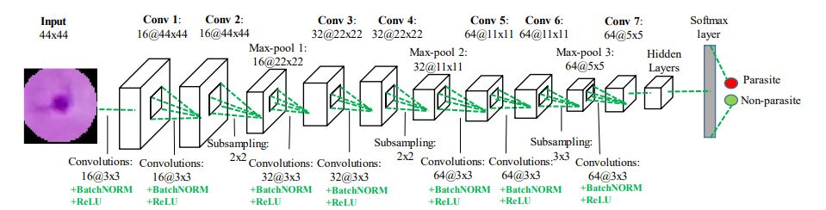
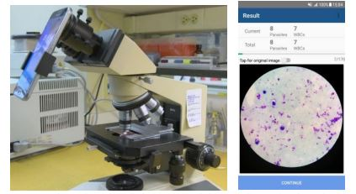
Parasite Classification:
CNN Model Structure:
The CNN model comprises 7 convolutional layers, 3 max-pooling layers, 3 fully connected layers, and a SoftMax layer.
Each convolutional layer incorporates batch normalization and ReLU activation functions to enhance learning.
Max-pooling layers are used for feature selection.
The model architecture is inspired by VGG19, specifically utilizing the first six convolutional layers for an optimal balance between performance and memory efficiency.
Classification Output:
The model generates a score vector, providing the probability that an image patch contains a parasite or is background.
An adaptive probability threshold can be applied to control the number of predicted parasites.
This approach offers several advantages over using pre-trained networks, including reduced runtime, lower memory requirements, and suitability for smartphone applications.
Notably, the proposed methodology can achieve parasite detection within approximately ten seconds when executed on a standard Android smartphone, ensuring practicality for field applications.

Slide 8
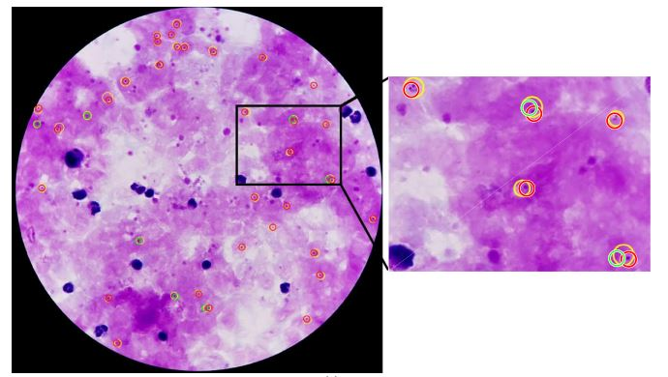
Results
Thick blood smear images from 150 P. falciparum infected patients in Bangladesh were captured with smart phones at 100x magnification in RGB.
The dataset contained 84,961 annotated parasites with varying radii (average: 22 pixels) and an average of 47 parasites per image.
Data was divided into two sets, Set A and Set B, at a 4:1 ratio for training and evaluation.
IGMS pre selection method achieved 97.04% sensitivity on the patch level and 97.49% on the image level for Set B.
The customized CNN model had robust performance with an AUC of 98.39%, high accuracy (93.46%), and strong correlations on image and patient levels. Pre-trained networks were outperformed by 5% to 23% in terms of sensitivity at a specificity of 98.39%.

Slide 9
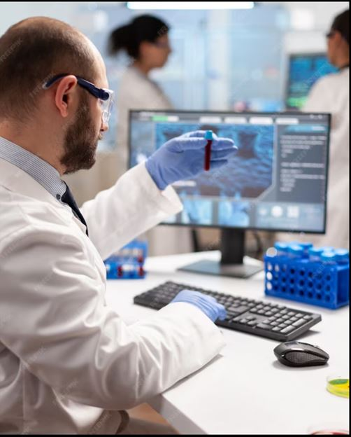
Critical Analysis:
Method Effectiveness: The methodology proves highly effective with high sensitivity, specificity, and accuracy, largely due to the efficiency of pre selection through IGMS and classification using the customized CNN model.
Handling False Positives: An innovative approach of generating false positives (negative patches) to enhance the CNN model's performance is employed.
Optimal Patch Size: Experimentation indicates the significance of selecting an optimal patch size to minimize false positives and background noise.
Comparison with Traditional Methods: A thorough comparison with traditional methods and pre-trained networks underscores the superiority of the customized CNN model.
Object Detection Networks: Notably, object detection networks such as faster-RCNN and YOLO are found to be less effective for detecting small objects like malaria parasites.

Slide 10
References:
L. Rosado, J. M. C. Da Costa, D. Elias, and J. S. Cardoso, “Automated Detection of Malaria Parasites on Thick Blood Smears via Mobile Devices,” Procedia Comput. Sci., vol. 90, no. July, pp. 138–144, Dec. 2016.
Z. Liang et al., "CNN-based image analysis for malaria diagnosis", Proc. IEEE Int. Conf. Bioinf. Biomed., pp. 493-496, 2017.
K. Torres et al., “Automated microscopy for routine malaria diagnosis: A field comparison on Giemsa-stained blood films in Peru,” Malar. J., vol. 17, no. 1, pp. 339–50, Sept. 2018.
Feng Yang, Mahdieh Poostchi, Hang Yu, Zhou Zhou, KamolratSilamut, Jian Yu, Richard J Maude, Stefan Jaeger, Sameer Antani., “Deep Learning for Smartphone-Based malaria parasite detection in thick blood smears.”, Proc. IEEE Int. Conf. Bioinf. Biomed., pp. 1427-1438, 2020.

